Slide 1



Coordination in Distributed Multi-User High-Performance Dense Networks (5G Synchronization: September Update)

Slide 2
Outline
What is Our Target?
Background
System model with phase noise (PN)
Difficulty of low complexity phase noise compensation (PNC)
What is the main strategy?
1st step: estimation of multiplication of channel (CH) and PN components
2nd step: separation of CH and PN components
Performance evaluation
Plan

Slide 3
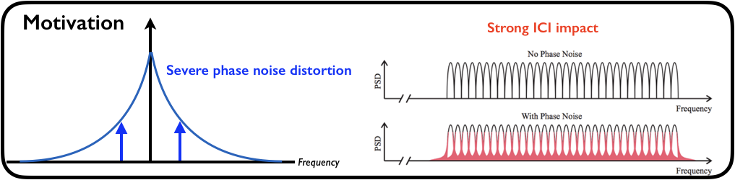
What is the Motivation?

Slide 4
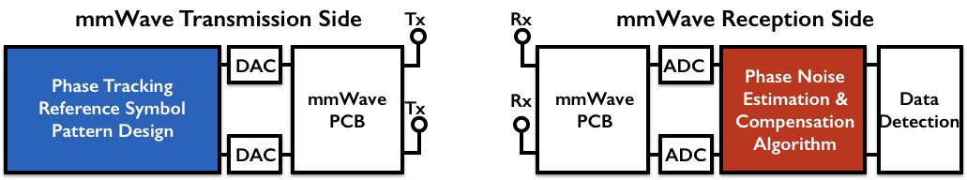
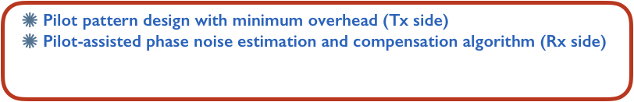
What is Our Target?

Slide 5
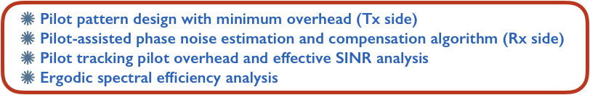
What is Our Target?

Slide 6
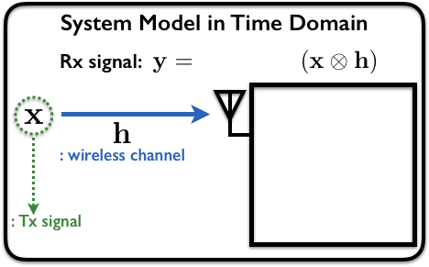
Background: System Model with Phase Noise (PN)

Slide 7
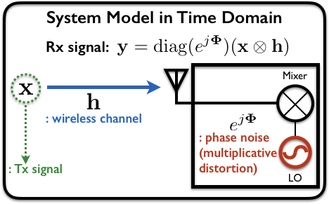
Background: System Model with Phase Noise (PN)

Slide 8
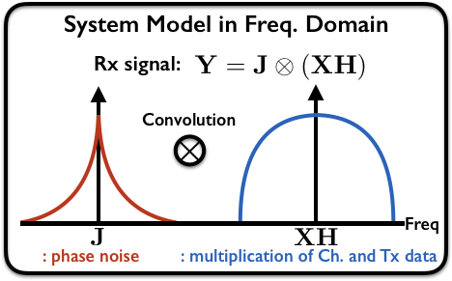
Background: System Model with Phase Noise (PN)

Slide 9
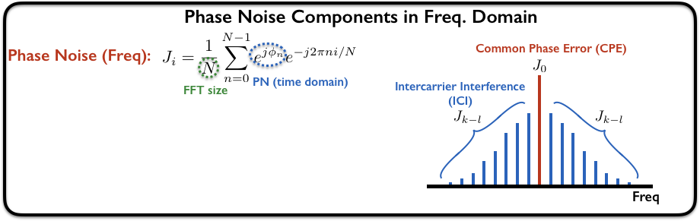
Background: System Model with Phase Noise (PN)

Slide 10
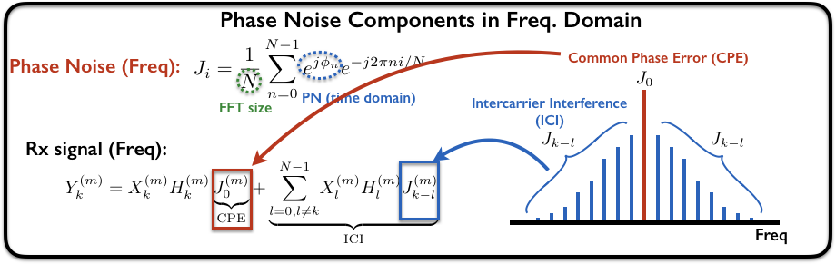
Background: System Model with Phase Noise (PN)

Slide 11
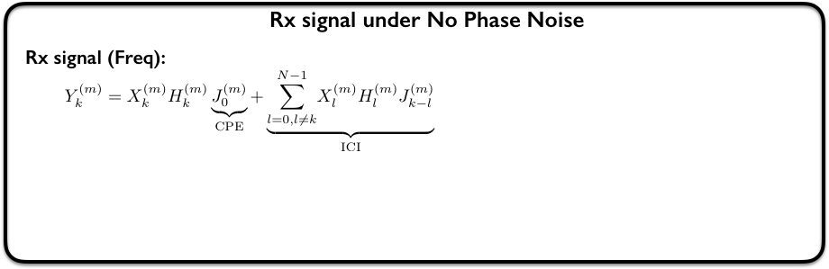
Background: Difficulty of Low Complexity PNC

Slide 12
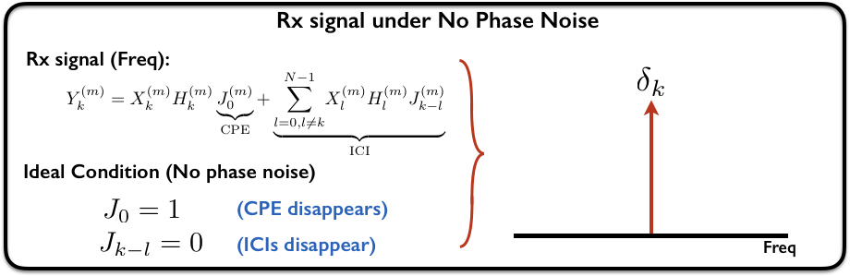
Background: Difficulty of Low Complexity PNC

Slide 13
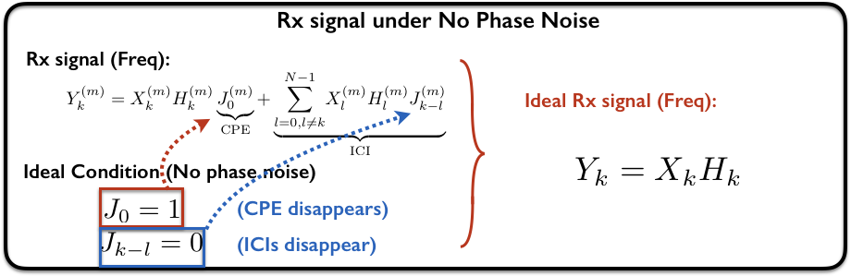
Background: Difficulty of Low Complexity PNC

Slide 14
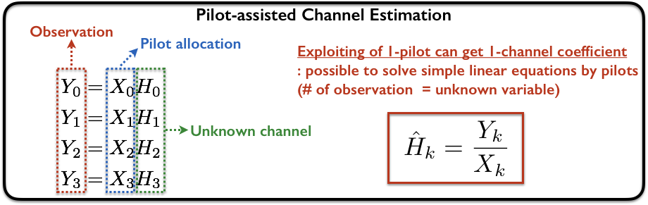
Background: Difficulty of Low Complexity PNC

Slide 15
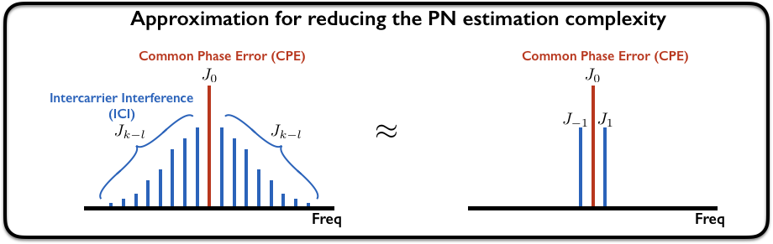
Background: Difficulty of Low Complexity PNC

Slide 16
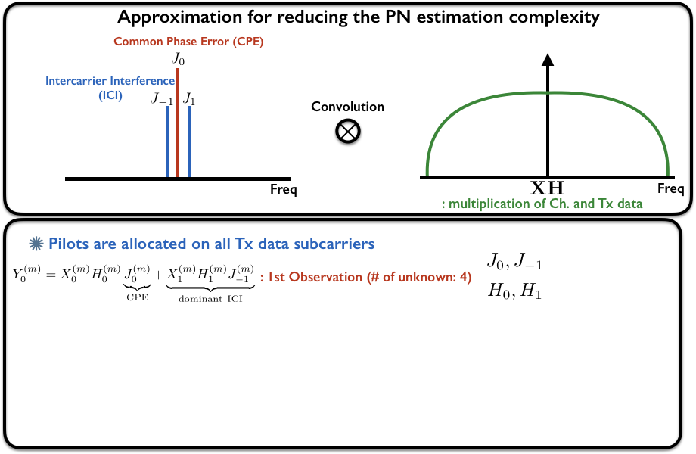
Background: Difficulty of Low Complexity PNC

Slide 17
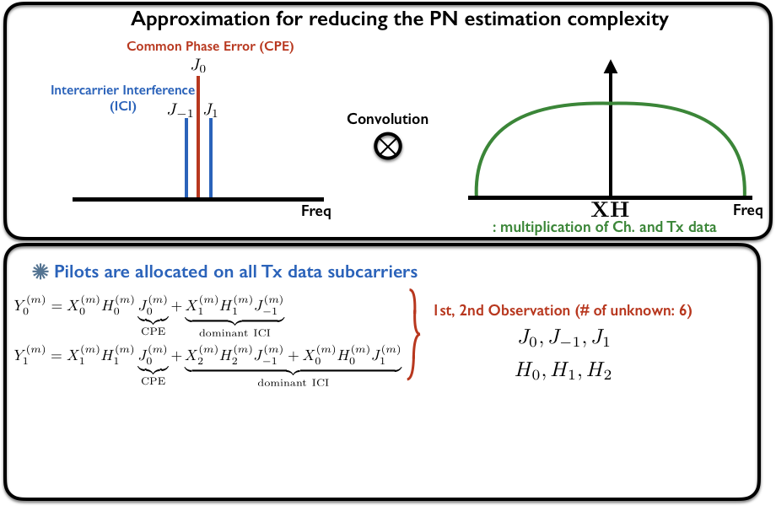
Background: Difficulty of Low Complexity PNC

Slide 18
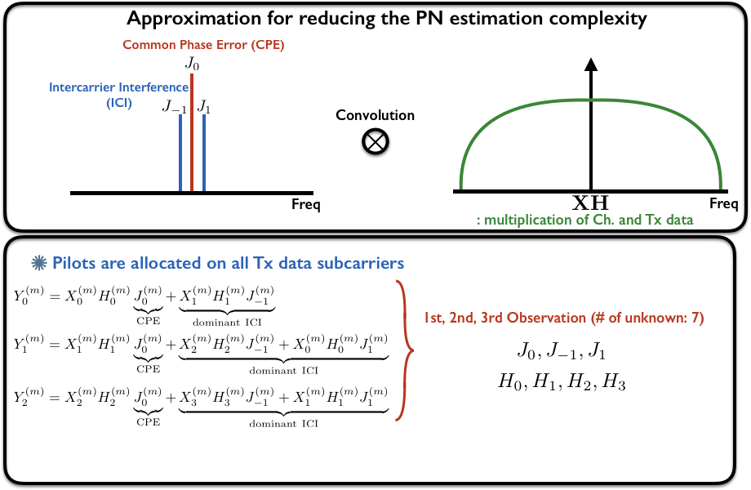
Background: Difficulty of Low Complexity PNC

Slide 19
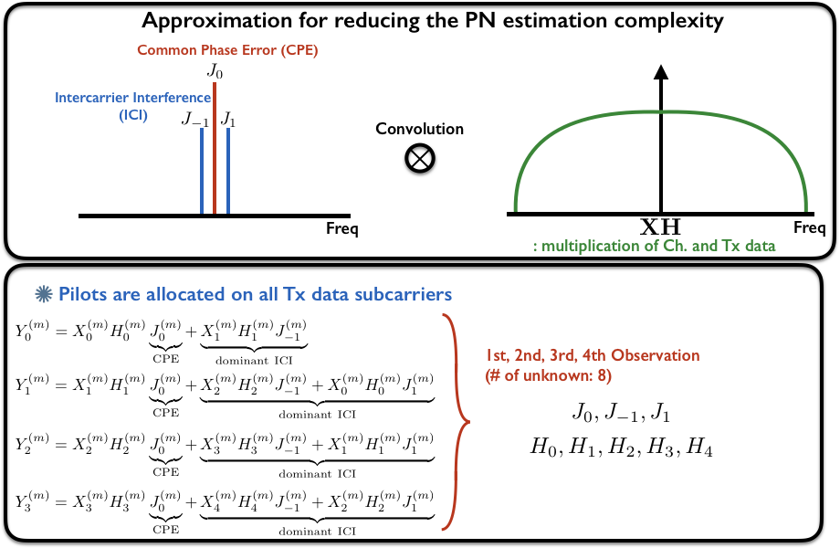
Background: Difficulty of Low Complexity PNC

Slide 20
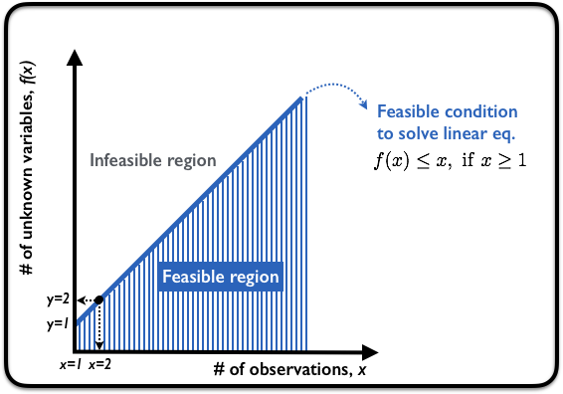
Background: Difficulty of Low Complexity PNC

Slide 21
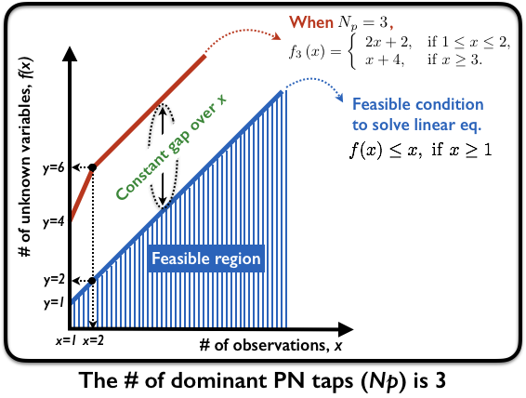
Background: Difficulty of Low Complexity PNC

Slide 22
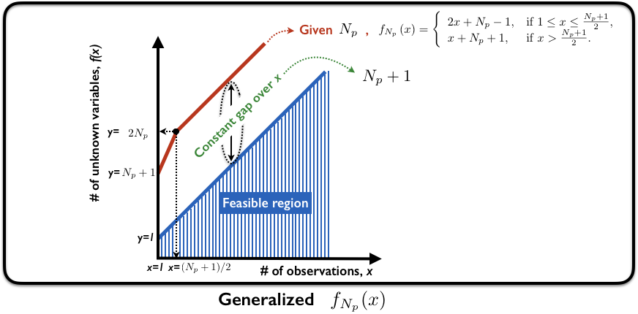
Background: Difficulty of Low Complexity PNC

Slide 23
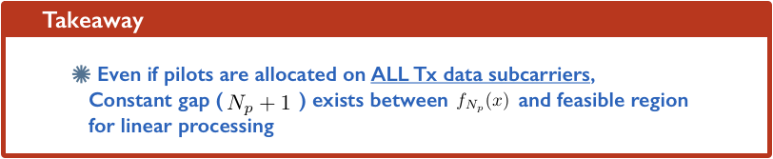
Background: Difficulty of Low Complexity PNC

Slide 24
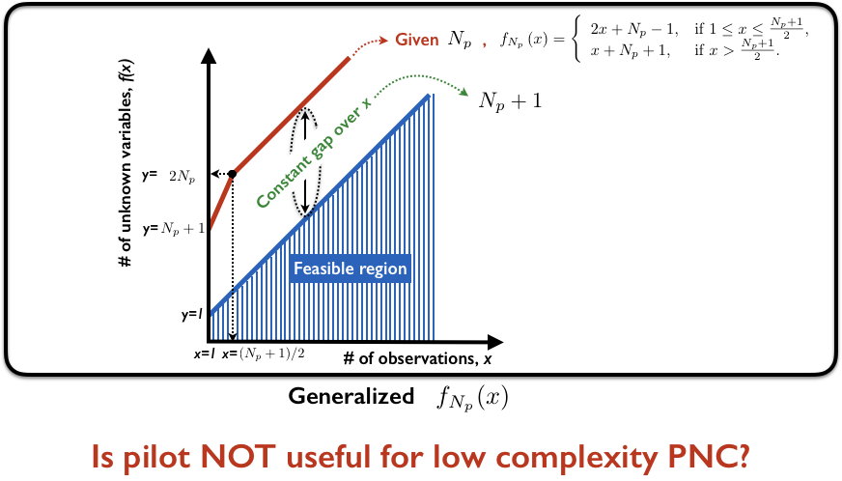
Background: Difficulty of Low Complexity PNC

Slide 25
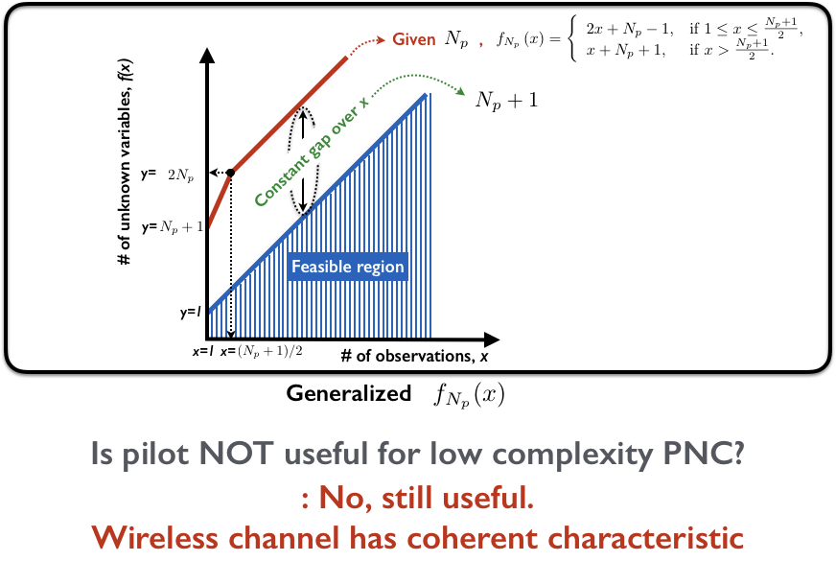
Background: Difficulty of Low Complexity PNC

Slide 26
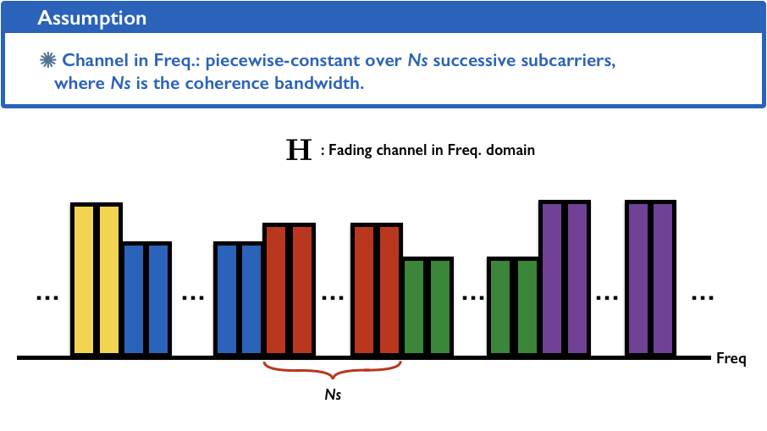
Our Idea: Utilizing Coherence Bandwidth

Slide 27
What is the Main Strategy?

Slide 28
What is the Key Strategy for PN Estimation?
1st step: Estimation of Multiplication of channel (CH) and PN components
2nd step: Separation of CH and PN components

Slide 29
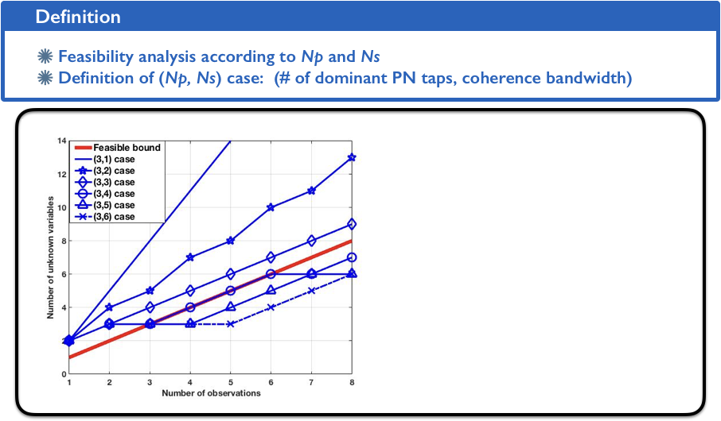
Background: Number of Combination of CH and PN

Slide 30
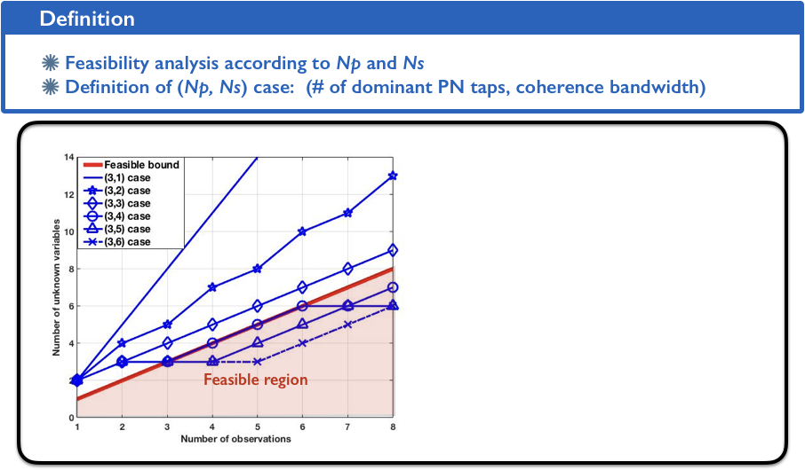
Algorithm (Step 1): Estimation of Multiplication of CH and PN

Slide 31
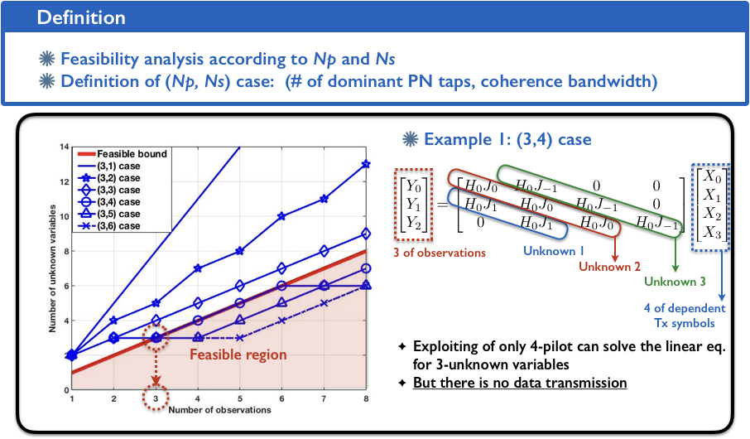
Algorithm (Step 1): Estimation of Multiplication of CH and PN

Slide 32
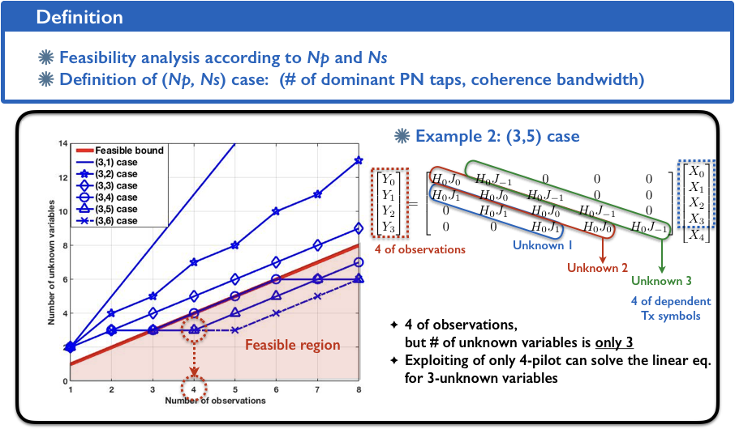
Algorithm (Step 1): Estimation of Multiplication of CH and PN

Slide 33
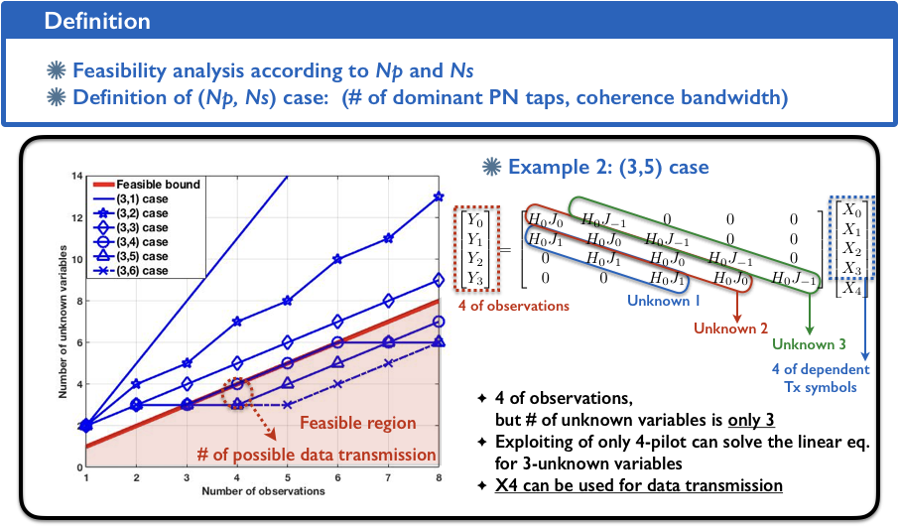
Algorithm (Step 1): Estimation of Multiplication of CH and PN

Slide 34
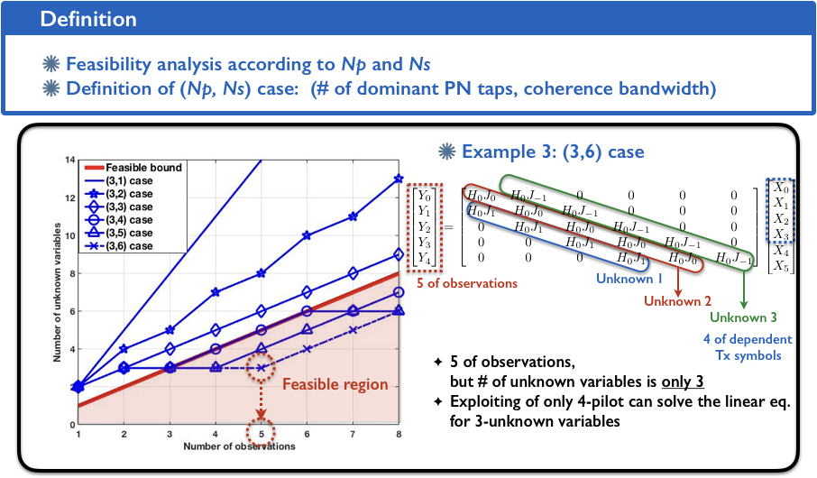
Algorithm (Step 1): Estimation of Multiplication of CH and PN

Slide 35
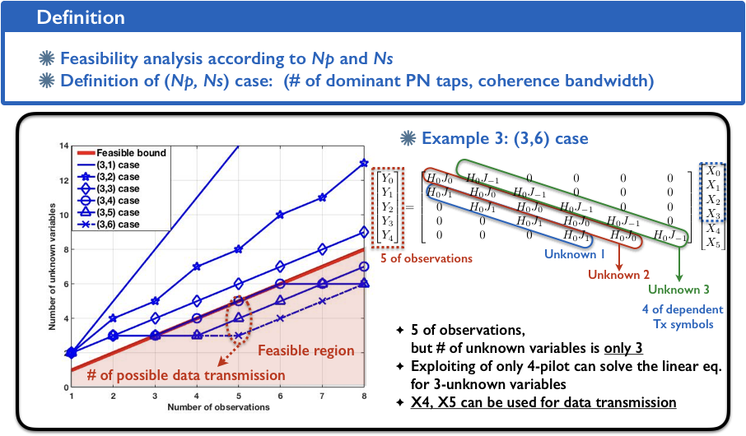
Algorithm (Step 1): Estimation of Multiplication of CH and PN

Slide 36
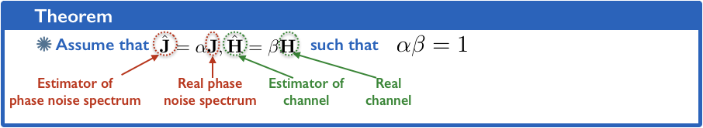
Algorithm (Step 2): Separation of CH and PN Components

Slide 37
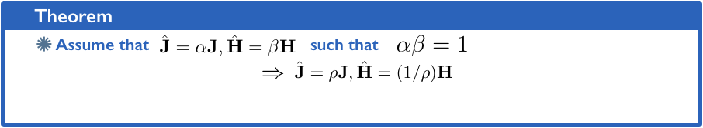
Algorithm (Step 2): Separation of CH and PN Components

Slide 38
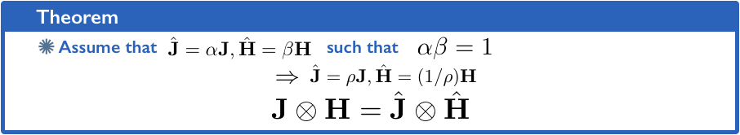
Algorithm (Step 2): Separation of CH and PN Components

Slide 39
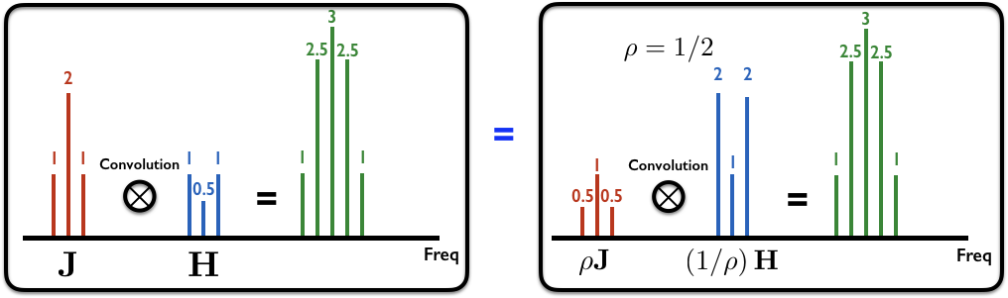
Algorithm (Step 2): Separation of CH and PN Components

Slide 40
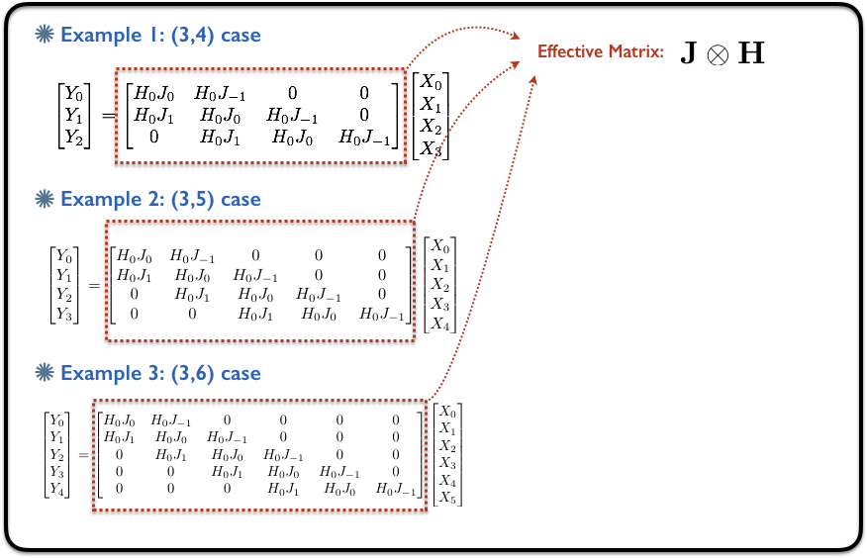
Algorithm (Step 2): Separation of CH and PN Components

Slide 41
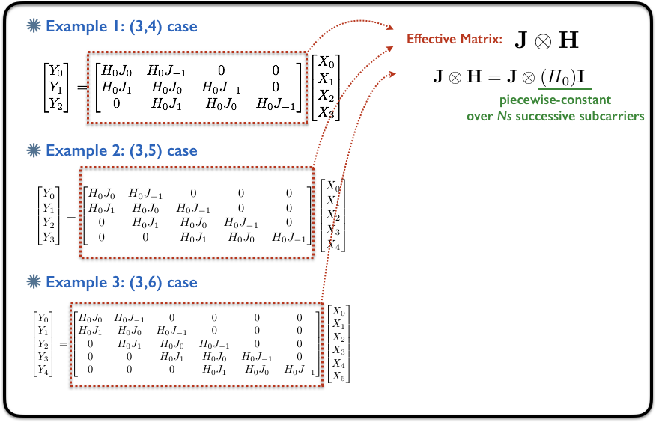
Algorithm (Step 2): Separation of CH and PN Components

Slide 42

Algorithm (Step 2): Separation of CH and PN Components

Slide 43
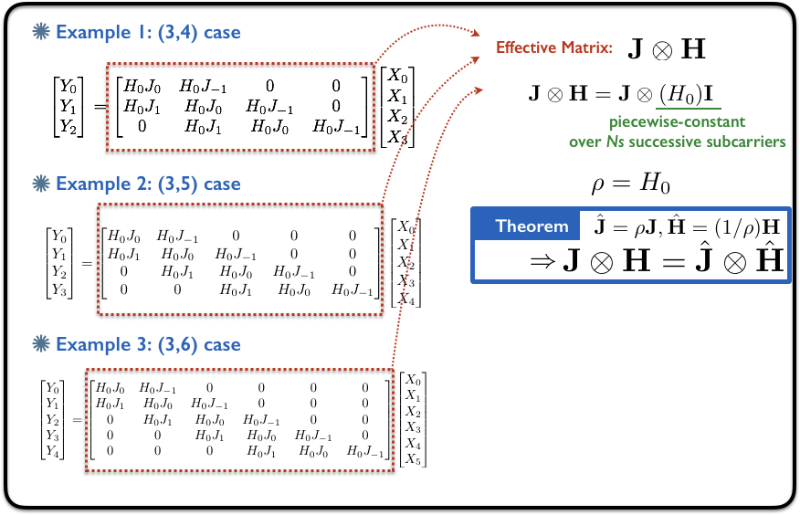
Algorithm (Step 2): Separation of CH and PN Components

Slide 44

Algorithm (Step 2): Separation of CH and PN Components

Slide 45
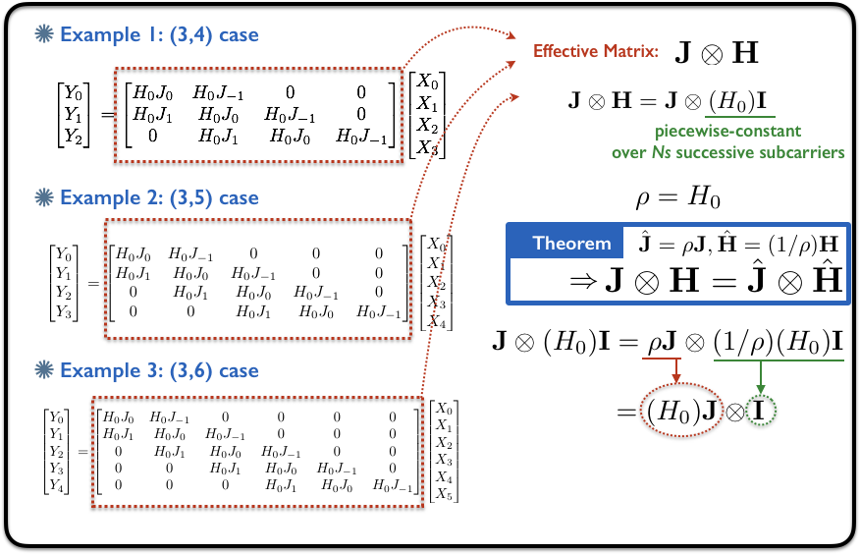
Algorithm (Step 2): Separation of CH and PN Components

Slide 46
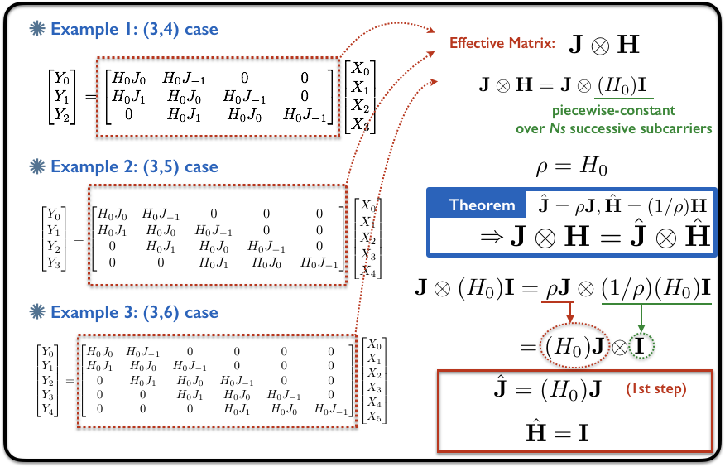
Algorithm (Step 2): Separation of CH and PN Components

Slide 47
Performance Evaluation

Slide 48
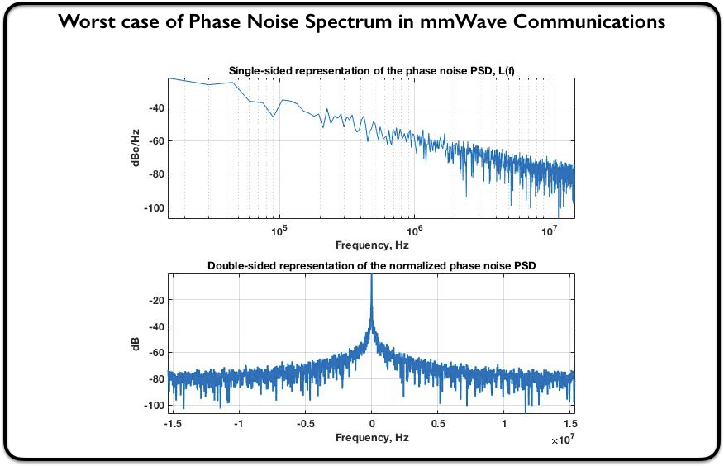
Performance Evaluation

Slide 49
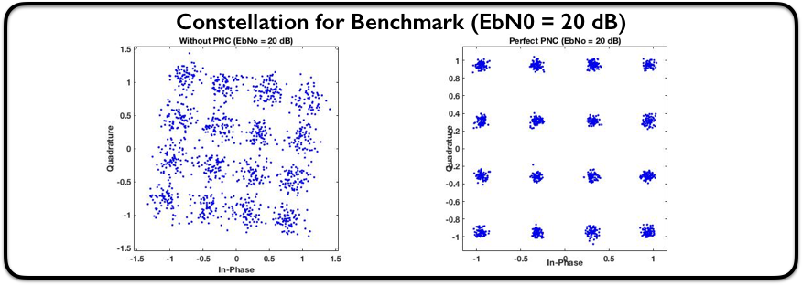
Performance Evaluation

Slide 50
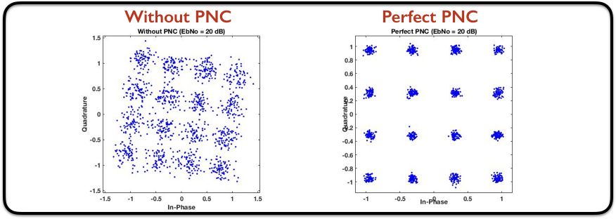
Performance Evaluation

Slide 51
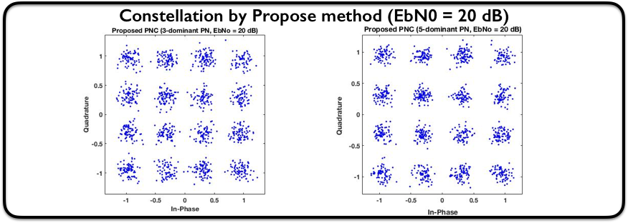
Performance Evaluation

Slide 52
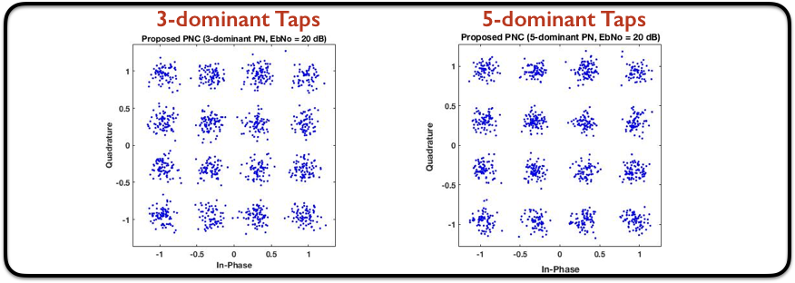
Performance Evaluation

Slide 53
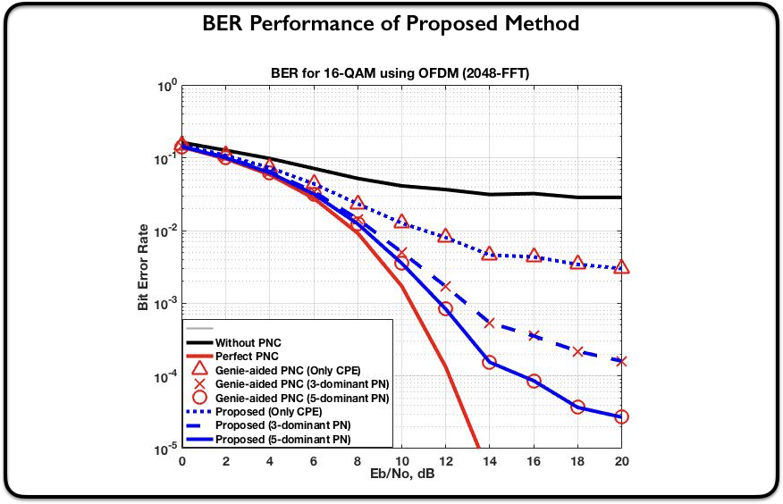
Performance Evaluation

Slide 54
Plan
Generalization of pilot pattern
Overhead/ SINR / Ergodic spectral efficiency bound analysis
Depending on LO quality
Depending on coherence bandwidth/coherence time
Implementation of PN estimation and compensation

Slide 55
Thanks!

